Slide 1
Survey of Graphics and Games

Slide 2
Outline
Overview of computer graphics
Coursework
Research
Programming using game engines
Computer game and animation industry information

Slide 3
Common computer graphics courses (taken from 2013 joint study by ACM and IEEE)
Fundamental Concepts
Basic Rendering
Geometric Modeling
Advanced Rendering
Computer Animation
Visualization

Slide 4
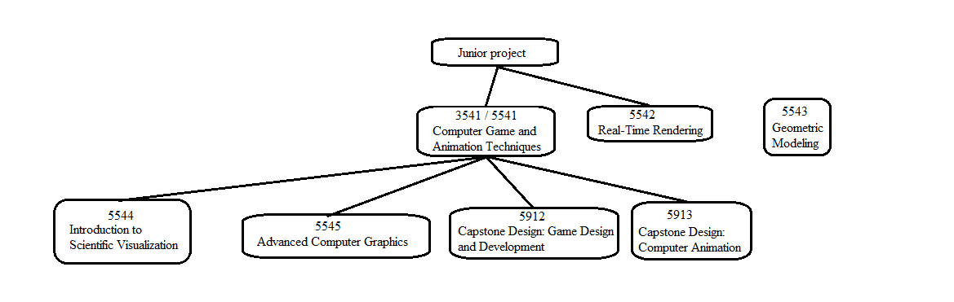
Computer graphics courses at OSU
Course offering trends (subject to change):
Multiple sections each semester – 3541
One section each semester – 5542, 5912
One section each spring – 5543
One section every other spring – 5544, 5545
Only on demand (express interest in the advising office):
5913
Follow-up to 3541 (analogous to AI 2)
Human Computer Interaction

Slide 5
ACCAD Classes at OSU
https://accad.osu.edu/academics
ACCAD 6002: Computer Game Art and Design I - 3 cr. Introduction to concepts for design and prototyping of games for entertainment, learning and social good. (Design 4104 for undergrads)
ACCAD 6003: Computer Game Art and Design II - 3 cr. Advanced topics for design and production of both fun and serious games including networked multi-player and mobile devices. Repeatable to a maximum of 9 cr hrs. (Design 4154 for undergrads)
The rest of the ACCAD catalog is extremely tempting!

Slide 6
Design Classes at OSU
OSU does have a department of design
https://design.osu.edu/
The game studies minor:
https://artsandsciences.osu.edu/sites/default/files/Game%20Studies%20Minor%20Updt%206-9-21.pdf
(You may already be planning to take some of the classes in that minor)
See: Design 3104, 4104, 4154

Slide 7
Game engines
Unity3D
Unreal Engine 5
Source 2
More exhaustive or comparative lists:
http://en.wikipedia.org/wiki/List_of_game_engines
http://www.moddb.com/engines/top
http://www.pixelprospector.com/the-big-list-of-game-making-tools/

Slide 8
Unity3D
Development
Develop on Windows or Mac
Games easily ported to run on many platforms
Engine written in C/C++
Scripting in C# or Javascript
Lots of documentation and tutorials
Not geared towards specific game genres
Licensing
Free for personal use
Doesn’t play well with academic organizational use

Slide 9
Unity example script
using UnityEngine;
using System.Collections;
public class Spin : MonoBehaviour
{
public float speed = 10f;
void Start() { // code to run when start is pressed }
void Update ()
{
transform.Rotate(Vector3.up, speed * Time.deltaTime);
}
}

Slide 10
Development in Unity3D vs. XNA
Image source:
http://code.google.com/p/bitverse-unity-gui/
Image source: http://docs.unity3d.com/Manual/UsingComponents.html

Slide 11
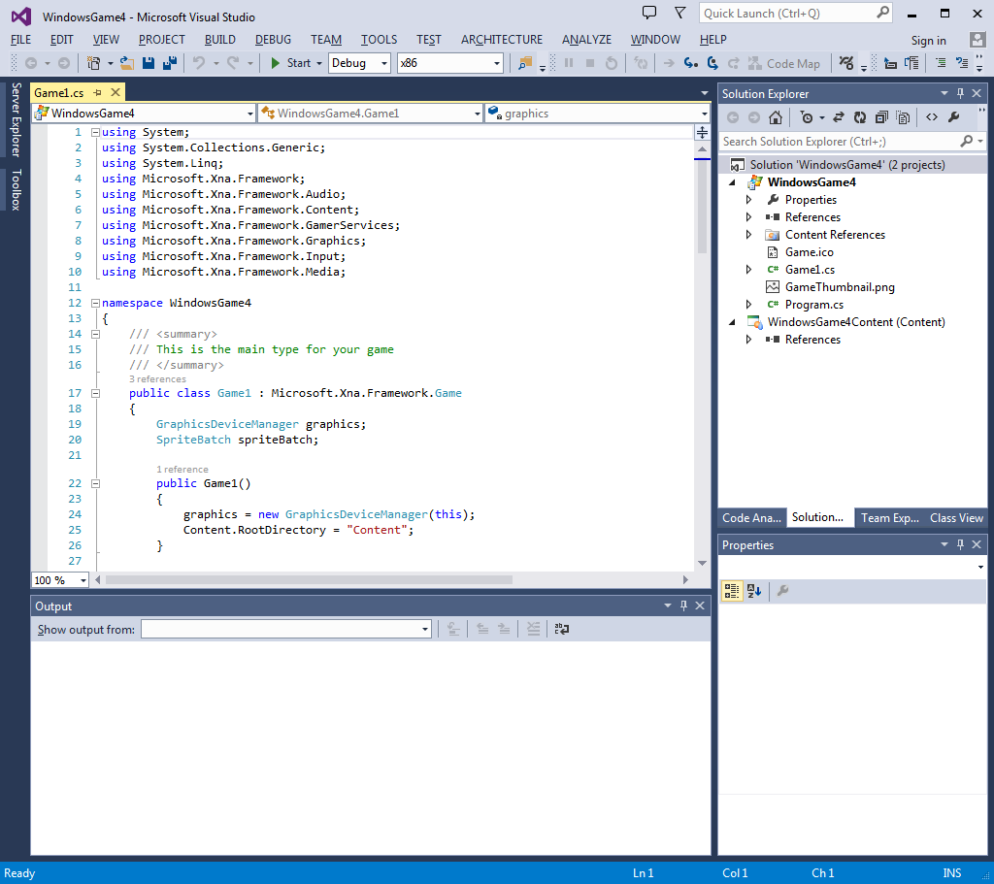
Development in Unity3D vs. XNA
Subset of XNA framework namespaces
Microsoft.Xna.Framework Provides commonly needed game classes such as timers and game loops.
Microsoft.Xna.Framework.Audio Contains low-level application programming interface (API) methods that can load and manipulate XACT-created project and content files to play audio. Microsoft.Xna.Framework.Content Contains the run-time components of the Content Pipeline. Microsoft.Xna.Framework.Graphics Contains low-level application programming interface (API) methods that take advantage of hardware acceleration capabilities to display 3D objects.
Microsoft.Xna.Framework.Input Contains classes to receive input from keyboard, mouse, and Xbox 360 Controller devices.
Microsoft.Xna.Framework.Net Contains classes that implement support for Xbox LIVE, multiplayer, and networking for XNA Framework games.

Slide 12
Unreal Engine 5
Development
Develop on Windows or Mac
Slightly more artist/designer friendly
Engine written in C++ and C#
Scripting in C++, Verse
Less learning resources than Unity but growing
Geared towards first/third person shooters and action genres
Used in film and television while filming (not in post!)
https://www.youtube.com/watch?v=gUnxzVOs3rk
Licensing
Free for personal use
Free for academic organizational use
Frequent version updates

Slide 13
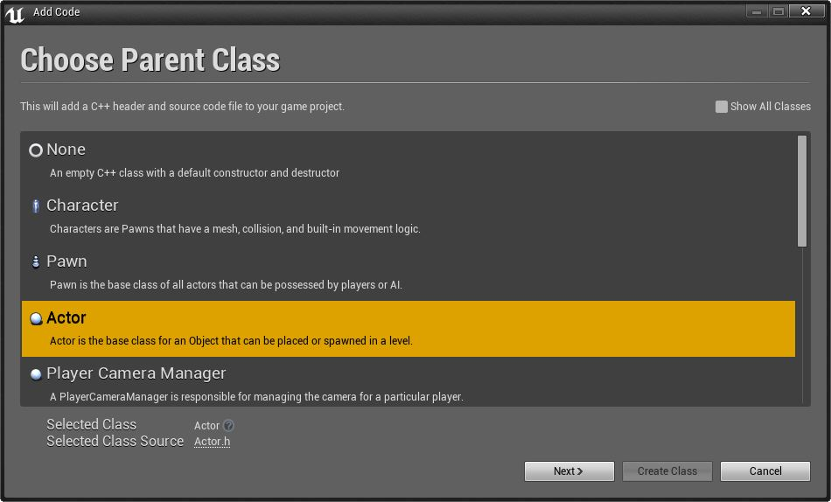
UE4 scripting example

Slide 14
UE4 scripting example

Slide 15
Source 2
Source 1
Written in C++
Scripting languages (Squirrel, Lua, Gamemonkey, Python)
Source 2
Announced at GDC 2015
Being used internally at Valve
Half-Life Alyx for VR (2020)
Aperture Desk Job for Steam Deck (2022)
Counter-Strike 2 (due 2023)
Licensing
Free for personal use
Academic organizational use?

Slide 16
Jobs in the computer game industry
Artist
Uses specialized tools to create art assets (concept art, textures, models, character rigs, etc.)
Designer
Uses game engine to make scenes, levels, scenarios, gameplay, etc.
Technical Artist
Uses art tools and does development, but with a specific focus area (modeling, shading, lighting, animation, etc.)
Developer (Technical Director in animation industry)
Writes code that implements or extends functionality of artist tools and/or game engines
A broader summary of positions can be found here http://creativeskillset.org/creative_industries/games/job_roles

Slide 17
Developer areas
Game engine
Graphics
Animation
Artificial Intelligence
Sound
Game logic / scripts
User Interfaces
Networking
Databases
Development tools
Systems/Parallel programming

Slide 18
Animation companies
Pixar http://www.pixar.com/careers
Dreamworks http://www.dreamworksanimation.com/jobs/
Disney http://www.disneyanimation.com/careers

Slide 19
Game development opportunities
EA Sports http://www.easports.com/careers
The Central Ohio GameDev Group https://www.meetup.com/The-Cogg/
Lumos https://www.facebook.com/LumosColumbus
A 2014 blog article on the best companies to work for and the supporting study by IGDA

